Slide 1
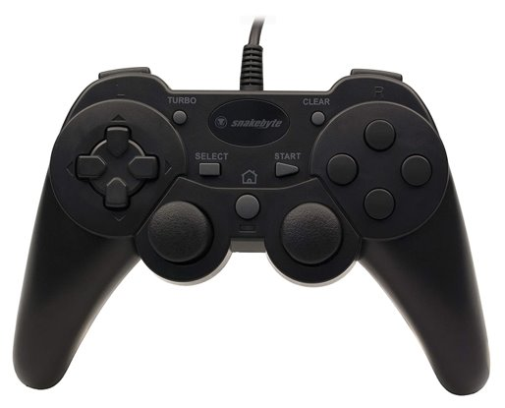
Zero-point turn left
D-Pad:
Up = Face camera forward
Right = Face camera right
Left = Face camera left
Down = Face camera backward
`. Open claw
Close claw
Move arm up
Move arm down
Quit simulation/disconnect from robot
Enter autonomous mode
Zero-point turn right
Main drive control

